Slide 1

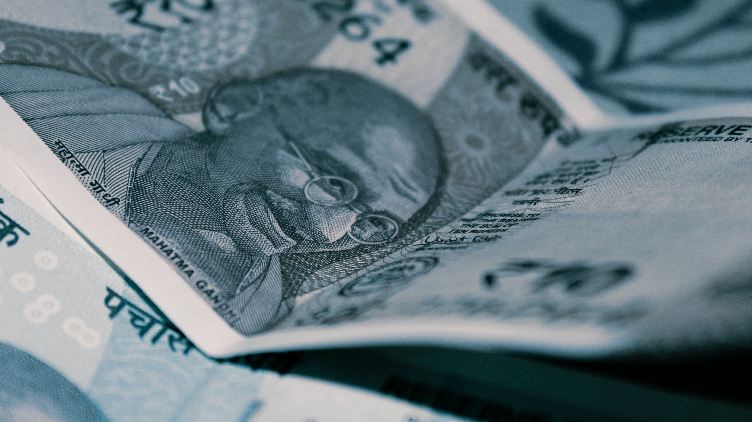



IDENTIFICATION OF FAKE INDIAN CURRENCY USING
CONVOLUTIONAL NEURAL NETWORK
GUIDE : DR.S.K.Harikarthik
BATCH: 6

Slide 2


TEAM MEMBERS
19L51A1209- HUSNA MEHWEEN
19L51A1212- KHADIJA MARYAM
19L51A1224- SANIYA AMREEN
19L51A1234- IBTESAM MOHAMMED ABDUL RUB

Slide 3

ABSTRACT
A fake version of the original currency is referred to as counterfeiting. In India, only the RBI is in charge of printing currency. Once screened and released into the market, counterfeit banknotes present an issue that the RBI must address every year. The printing and scanning industries' significant technological advancements caused the counterfeiting problem to worsen. Therefore, counterfeit money has an impact on the economy and lowers the value of real money. The majority of the earlier systems rely on hardware and image processing methods. These techniques are less effective and take more effort to find fake money. To overcome the above problem, we have proposed the Identification of Fake Indian Currency using Xception Architecture. Through analysis of the currency images, our technique detects counterfeit money. Indian currency data sets for the 2000 and 500 rupee notes are used to train the Xception Architecture to learn the feature map of the respective currencies. The network is prepared to recognize fraudulent currencies in real time after the feature map has been learned. The suggested method takes less time and effectively detects forgeries of the 2000 and 500 currencies. The training accuracy of our suggested model was 93.34%, and the validation accuracy was 97.00%.
This Photo by Unknown author is licensed under CC BY-SA.

Slide 4
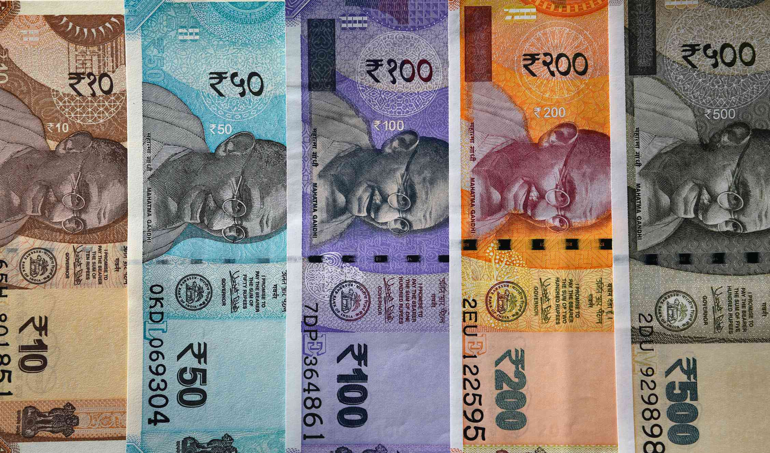
INTRODUCTION
Counterfeit currency is a major issue around the world, it influencing the economy of various countries. In India Reserve Bank of India is only give the approval to banks for generating the currency. In India many of the people have been working on daily basis, hence workers, farmers and uneducated people facing the problems with the counterfeit currency. They are unable to identify the fake currency. In order to overcome these problems researches proposed the various image processing algorithms such as recognition, identification of denomination, counterfeit detection and currency classification. These are used in automatic counting machines, vending machines and automatic transactions. But counterfeit detection and classification is challenging issue in many applications.
To overcome this problem deep learning with convolutional neural networks (CNN) type of model Xception network came into the picture. four predefined networks i.e Alexnet, Resnet50, Darknet53 and Googlenet have been used to detect the fake Indian currency. .

Slide 5

SCOPE OF THE PROJECT
The scope of this project is to develop a system that can accurately detect counterfeit Indian currency notes in real time using Xception Architecture.
The system will be trained on datasets of genuine and counterfeit 2000 and 500 rupee notes, and will achieve high accuracy in detecting forgeries.
The system can be deployed in banks, ATMs, and other financial institutions to help combat the issue of counterfeit currency in India.

Slide 6

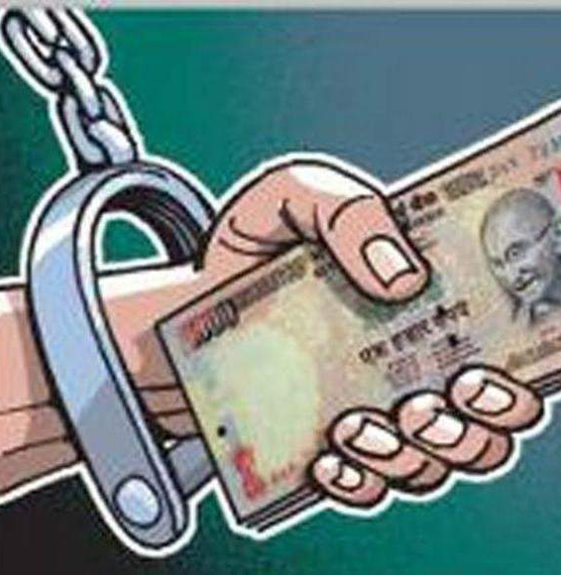


OBJECTIVE
To identify fake Indian currency using machine learning techniques such as Xception Architecture.
The system will be trained on large datasets of Indian currency notes, with a focus on the 2000 and 500 rupee notes, to learn the features that are unique to each denomination.
The goal is to achieve high accuracy in detecting fake notes in real-time scenarios, thus providing a secure mechanism for financial transactions.

Slide 7
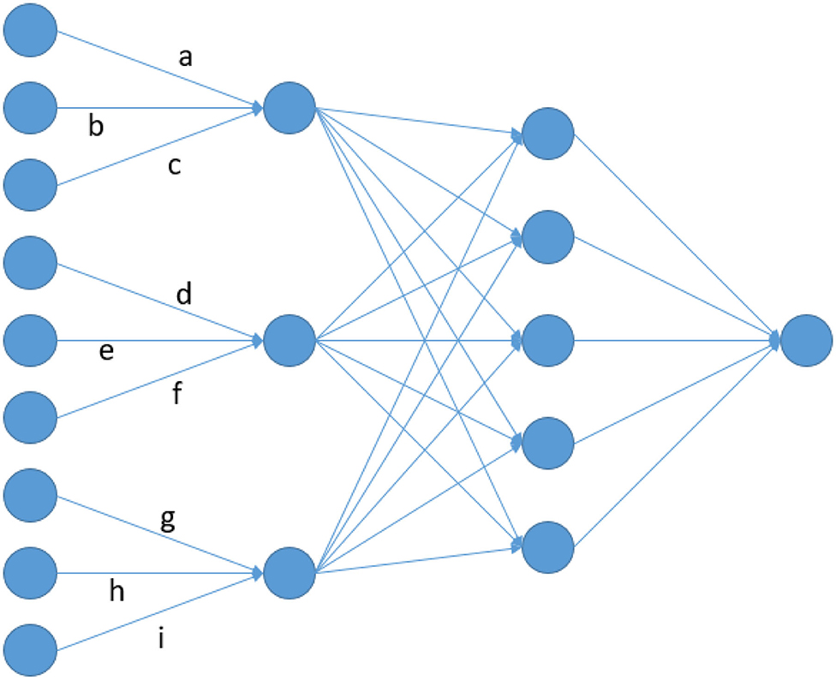
EXISTING SYSTEM
In today's world scenario, paper currency is economical in the sense that its face value is greater than intrinsic value. It is also more elastic and stable, paper currency can be counted quickly, it is easy to move and safe to store.
Fake currency cannot be identified by human vision and due to this recognition of forged currency notes has become crucial problem because counterfeiters are using new and improved methods.
The methods currently existing to determine whether the notes are real cannot be accessed by the common people and are also complex hardware-based methods.
In this system, the Indian currency note features would be primarily extracted using Convolutional Neural Networks (CNNs).
EXISTING SYSTEM DISADVANTAGES:
They fail to encode the position and orientation of objects.
It tends to be much slower because of operations like Maxpool.
This Photo by Unknown author is licensed under CC BY.

Slide 8

EXISTING TECHNIQUE
Convolutional Neural Networks (CNN)
The four predefined convolutional neural networks have been used to extract the features of real and fake Indian currency.
Each predefined network mainly consists of the
convolutional layer
pooling layer
ReLu layer
fully connected layer
Softmax layer
This Photo by Unknown author is licensed under CC BY-SA.

Slide 9





LITERATURE SURVEY
Title: A survey on bank note recognition methods by various sensors
Author: J. Lee, H. Hong, K. Kim, and K. Park
Year: 2017.
Description: real money transactions remain very important in the global market. While performing transactions with real money, touching and counting notes by hand, is still a common practice in daily life, various types of automated machines, such as ATMs and banknote counters, are essential for large-scale and safe transactions. This presents studies that have been conducted in four major areas of research (banknote recognition, counterfeit banknote detection, serial number recognition, and fitness classification) in the accurate banknote recognition field by various sensors in such automated machines. Techniques used in each of the four areas recognize banknote information (denomination, serial number, authenticity, and physical condition) based on image or sensor data, and are actually applied to banknote processing machines across the world.

Slide 10
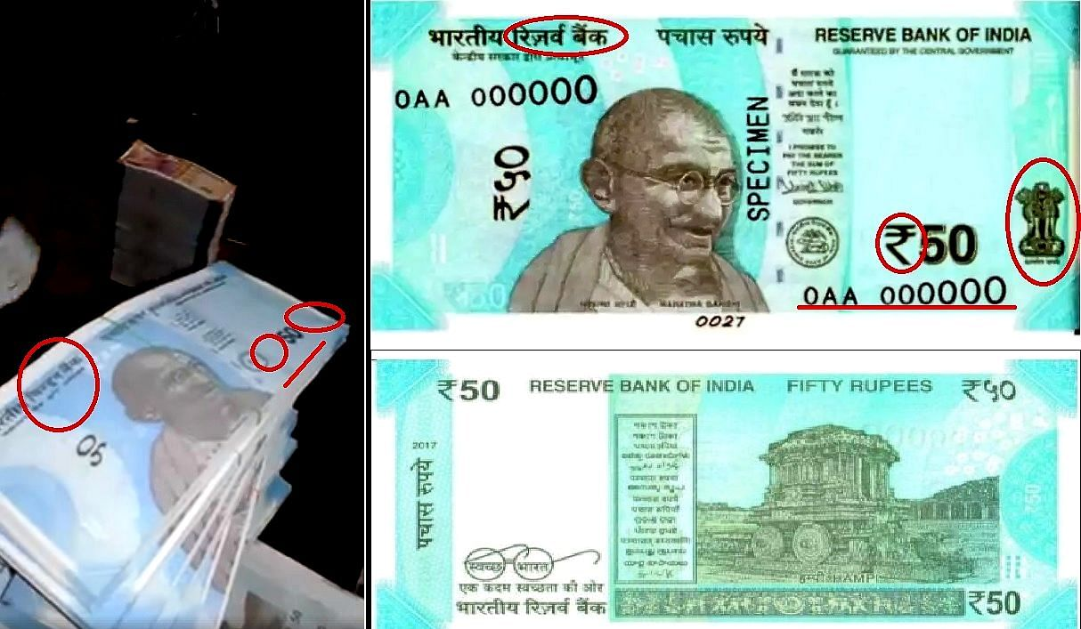
Title: A Survey on Fake Indian Paper Currency Identification System
Author: P. Julia Grace, A. Sheema
Year: 2016.
Description: Fake notes in India are being flooded into the system. The main focus of the standard paper currency identification system is on recognizing forged currencies. The currency identification system is a must and it is essential that it should be very accurate. A thriving approach to paper currency identification depends upon a number of steps, including edge detection, feature extraction, image segmentation, image acquisition, grayscale conversion, and comparison of images. In this paper, we have gone through a different type of literature survey which describes different techniques of counterfeit currency identification. We conclude, when we apply some efficient pre-processing and feature extraction techniques, we can still improve the accuracy of currency identification system.

Slide 11
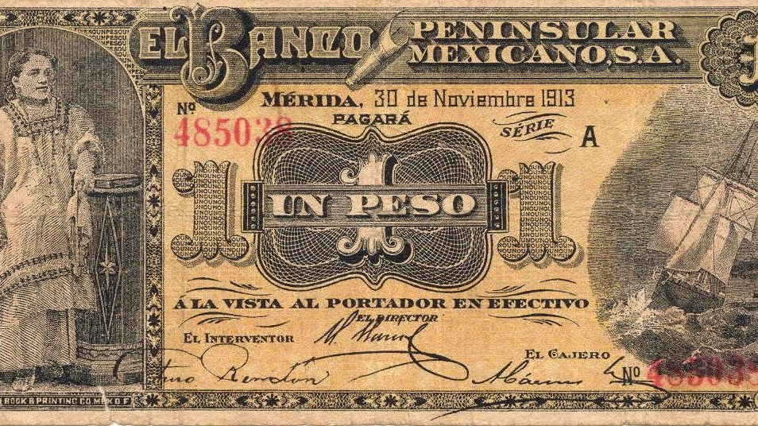
Title: Recognition system for euro and Mexican banknotes based on deep learning with real scene images
Author: D. Galeana P érez and E. B. Corrochano
Year: 2018
Description: A high banknote recognition and classification rate was achieved using neural networks and deep learning with real scene images taken with both sunlight and artificial light. Without extracting characteristics by hand, the convolutional neural networks was fed with raw images. Analysis and experiments were carried out on banknotes based on key features, such as; watermarks, portraits on the bills, bill value written in words and numbers, and the complete banknotes. It was concluded that both the color information and some regions of the banknotes, as well as the banknote denomination written in words and numbers and the complete banknote, is the appropriate information to achieve a high rate of banknote classification and recognition. A high recognition rate was achieved for Mexican banknotes and for euros.

Slide 12

PROPOSED SYSTEM
The conventional methods based on color, size, texture and shape identify the fake currency.
Edge detection, Watermarking, feature extraction, segmentation methods have been used to detect the fake currency.
The major steps involved in the process of identification and recognition of fake currency is creating database of particular country, converting RGB to grayscale image, segmentation is used to segment the logo, currency value, number and signature of the governor.
In the conventional methods feature extraction is major issue to detect the fake currency and these are also providing the less accuracy. To overcome this problem deep learning with Xception network came into the picture.
A Xception Architecture is proposed for Fake Indian Currency detection achieves a success rate of good prediction, outperforming the existing work.
PROPOSED SYSTEM ADVANTAGES:
It vastly outperforms it on a larger image classification dataset.
It has the same number of model parameters as Inception, implying a greater computational efficiency.
It slightly outperforms Inception v3 on the ImageNet dataset

Slide 13

PROPOSED TECHNIQUE
Xception Architecture.
Xception is a deep convolutional neural network architecture that involves Depthwise Separable Convolutions.
It was developed by Google researchers. Google presented an interpretation of Inception modules in convolutional neural networks as being an intermediate step in-between regular convolution and the depthwise separable convolution operation (a depthwise convolution followed by a pointwise convolution).

Slide 14

MODULES NAME:
Dataset
Importing the necessary libraries
Retrieving the images
Splitting the dataset
Building the model
Apply the model and plot the graphs for accuracy and loss
Accuracy on test set
Saving the Trained Model

Slide 15
SYSTEM REQUIREMENTS
HARDWARE REQUIREMENTS
PROCESSOR
RAM
HARD DISK
:
:
:
DUAL CORE 2 DUOS. 4GB DD RAM
250 GB
SOFTWARE REQUIREMENTS​
​
OPERATING SYSTEM : WINDOWS 7/8/10​
PLATFORM : SPYDER3​
PROGRAMMING LANGUAGE : PYTHON​
FRONT END : HTML,CSS​

Slide 16

FUNCTIONAL REQUIREMENTS
A functional requirement defines a function of a software-system or its component. A function is described as a set of inputs. Firstly, the system is the first that achieves the standard notion of semantic security for data confidentiality in attribute-based deduplication systems by resorting to the hybrid cloud architecture.
NON-FUNCTIONAL REQUIREMENTS​
Usability​
Reliability​
Performance.​
Supportability​
Implementation

Slide 17
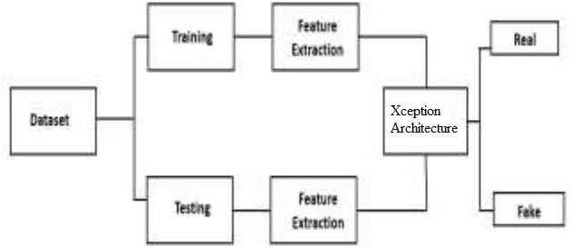
SYSTEM ARCHITECTURE
Fig : System Architecture

Slide 18
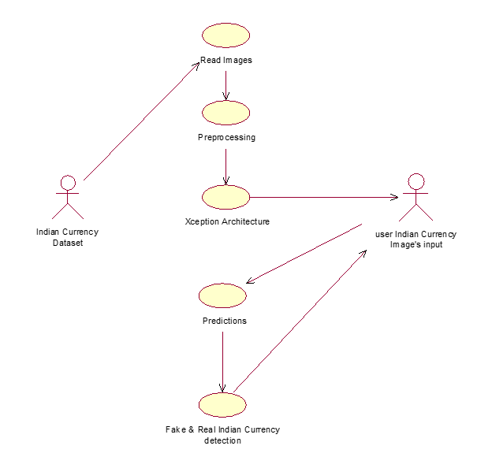
UML DIAGRAMS
USE CASE DIAGRAM

Slide 19
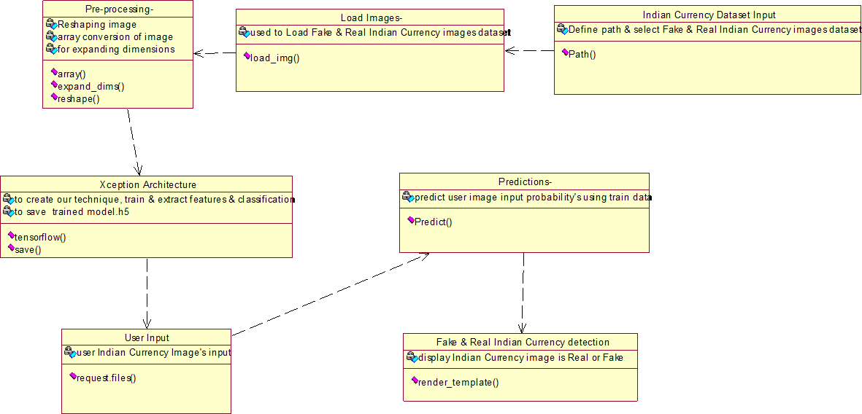
CLASS DIAGRAM

Slide 20
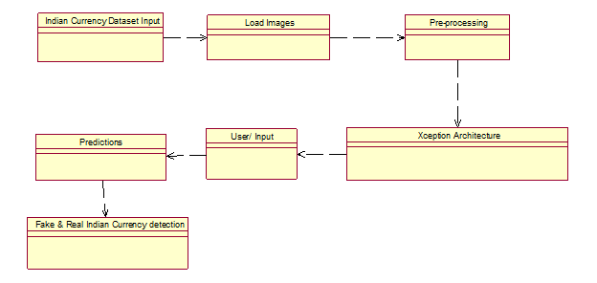
4.2.3 OBJECT DIAGRAM
Pre-processing
OBJECT DIAGRAM

Slide 21
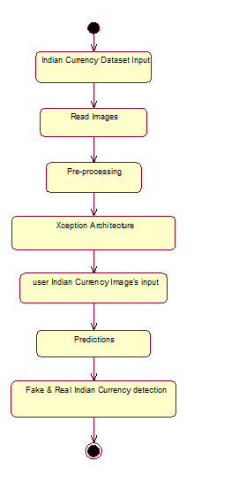
Indian Currency Dataset Input
STATE DIAGRAM
user Indian Currency Image’s input
user Indian Currency Image's input

Slide 22
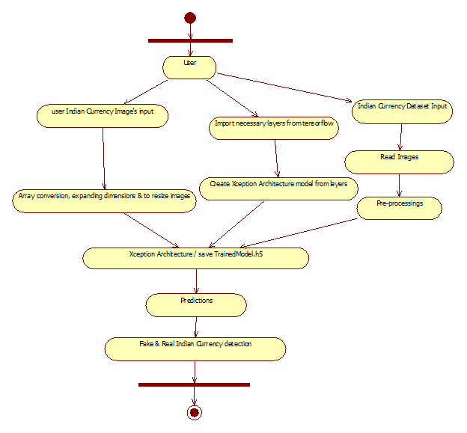
user Indian Currency Image’s input
ACTIVITY DIAGRAM

Slide 23
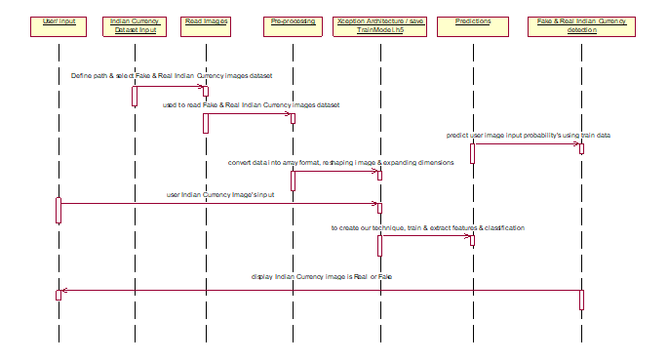
predict user image input probability's using train data
convert data into array format, reshaping image & expanding dimensions
SEQUENCE DIAGRAM

Slide 24
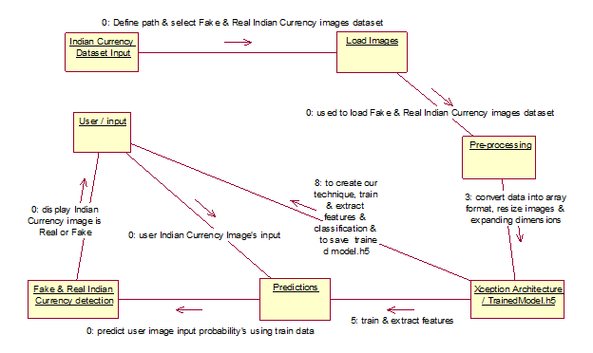
COLLABORATION DIAGRAM

Slide 25
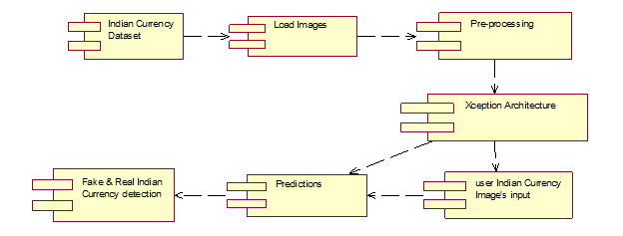
COMPONENT DIAGRAM

Slide 26
Indian Currency Dataset
DATA FLOW DIAGRAM
Level 0
User
Read Images & Pre- processing​
Apply Xception Architecture & save trained file like TrainedModel.h5

Slide 27
Import necessary layers from tensorflow
DATA FLOW DIAGRAM
Level 1
User
Understand about layers
Create Xception Architecture using tensor-flow layers

Slide 28
user Indian Currency Image’s input
DATA FLOW DIAGRAM
Level 2
Array conversion, expanding dimensions & resize images
Loads related TrainedModel.h5 & apply converted data
Fake & Real Indian Currency detection

Slide 29
DEPLOYMENT DIAGRAM

Slide 30
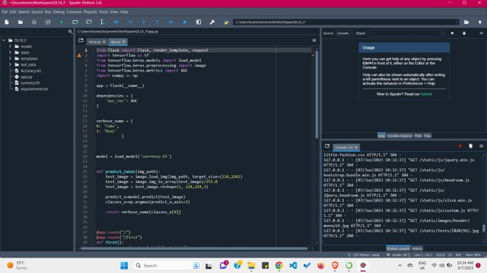
SAMPLE CODE

Slide 31
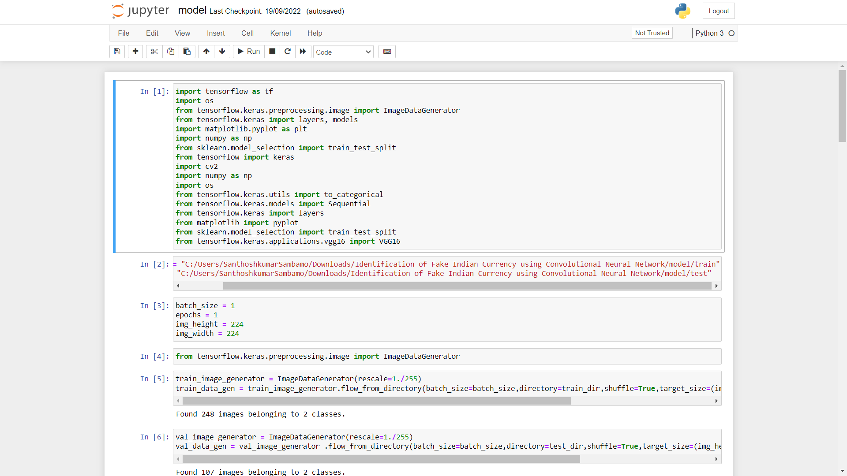
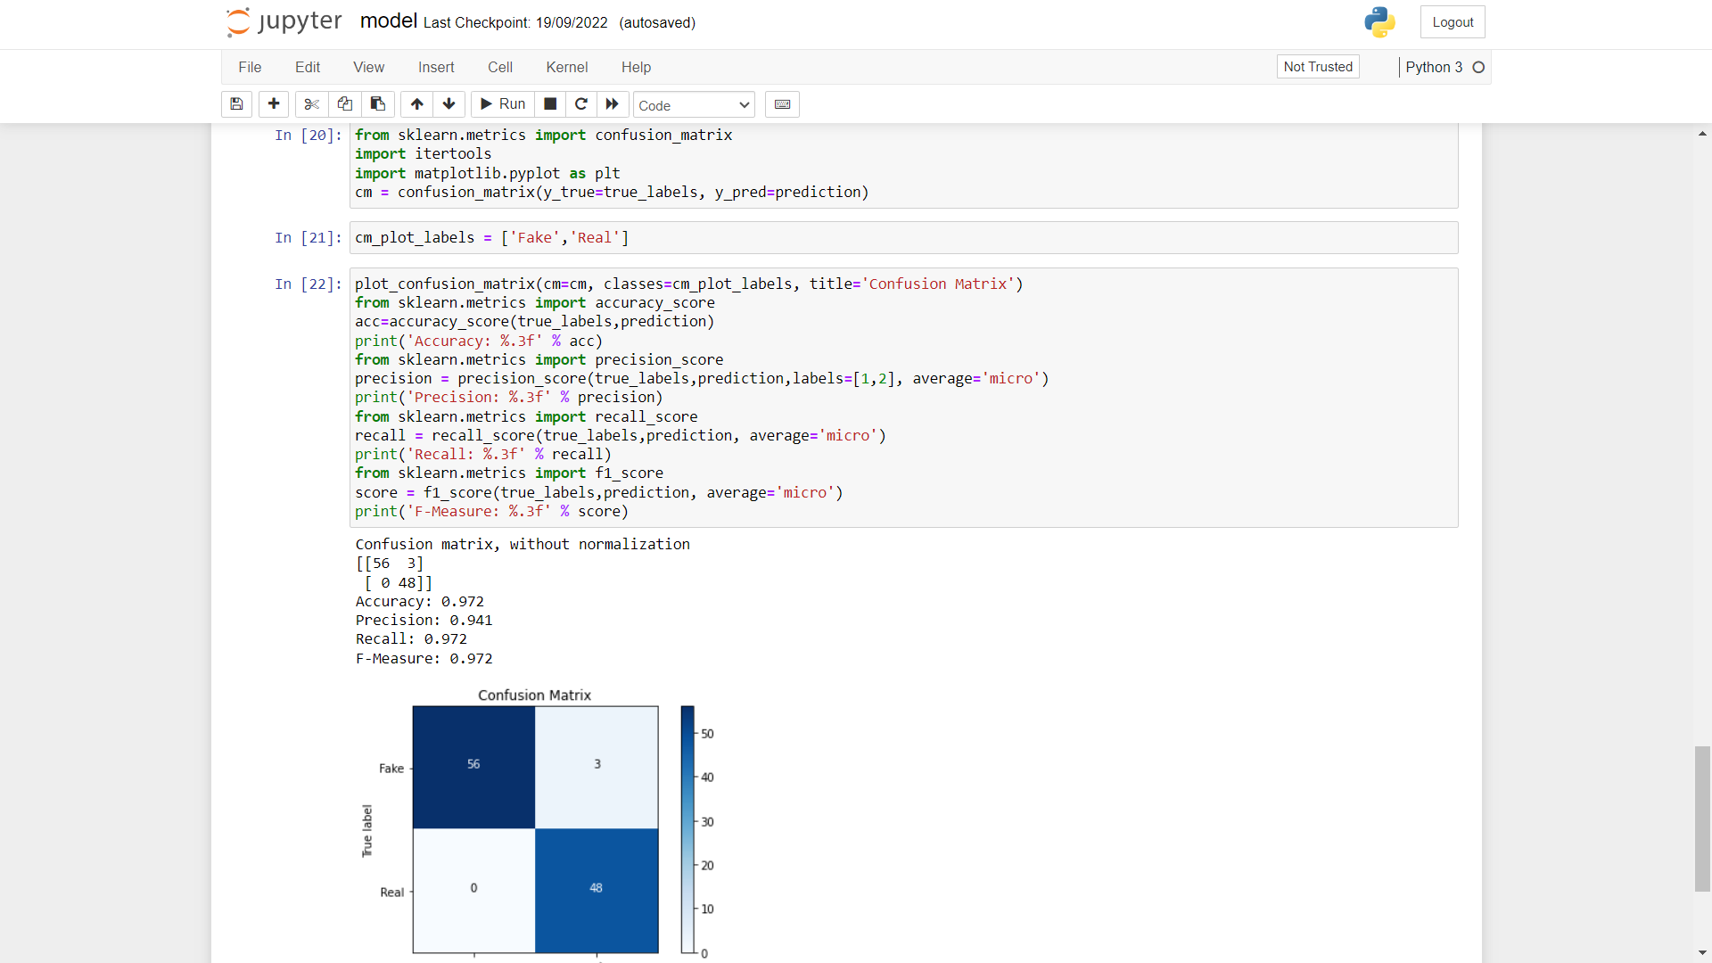

Slide 32


CHAPTER 7
SNAPSHOTS

Slide 33
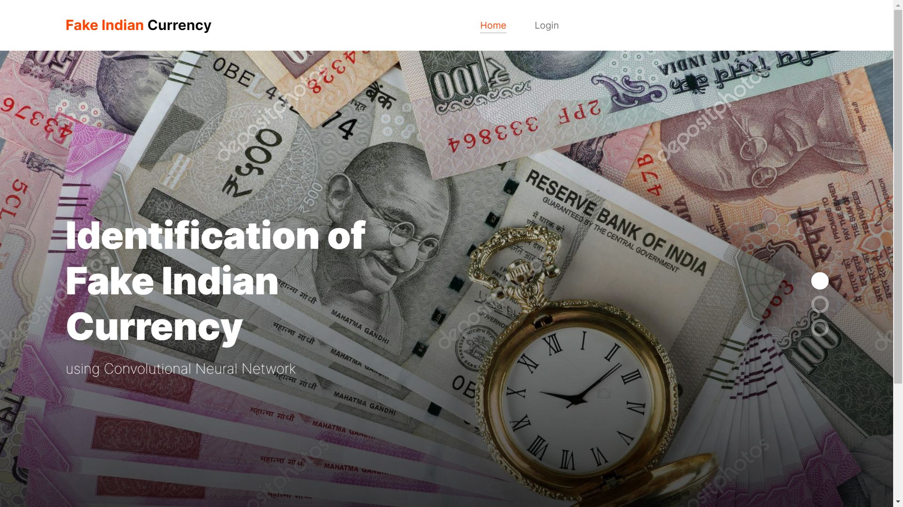
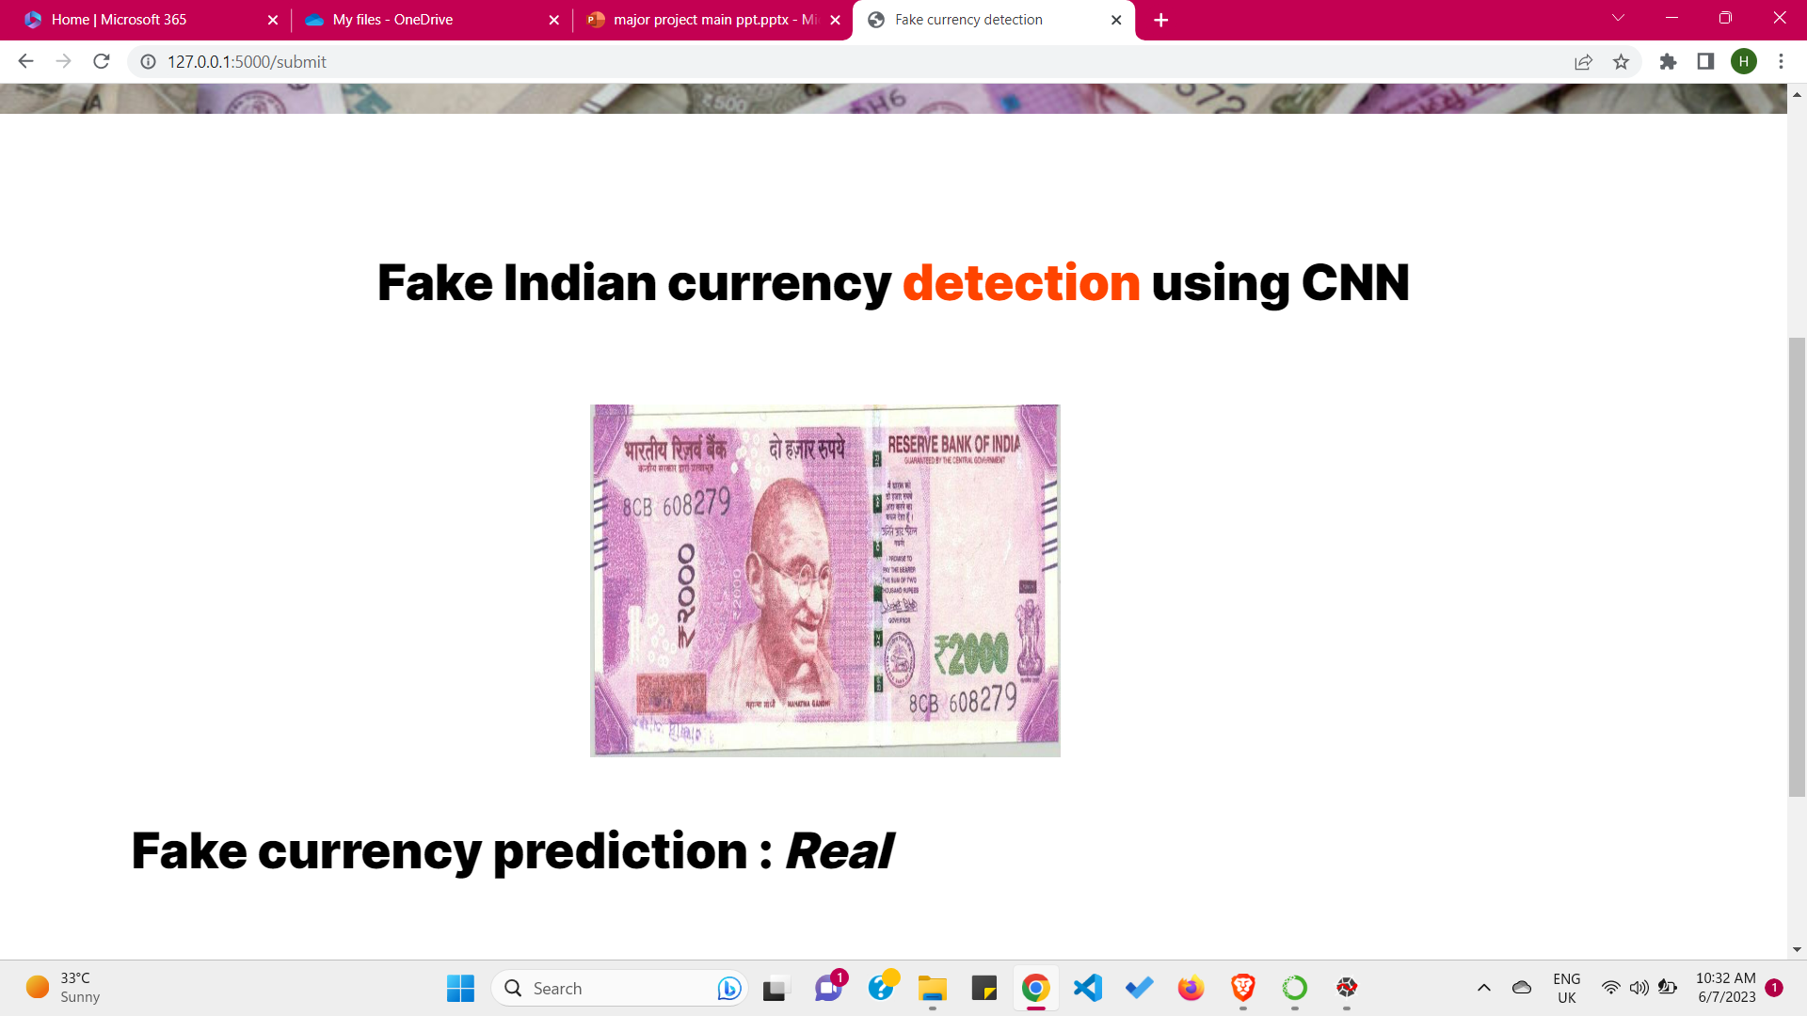

Slide 34
FUTURE ENHANCEMENT
In this proposed system we have used Xception Architecture as our model for performing the fake currency detection. The detection accuracy is most accurate since the currency characteristics features are learned through layer by layer. Here we have considered the whole currency image, but in future we will try to include all the security features of currency by employing suitable structural design and with suitable training data. Further, noise may be present in the captured image which has to be considered as a pre-processing step in currency detection process.

Slide 35
CONCLUSION
Day by day the rate of fake notes in the market are increasing rapidly. Currently there are various technologies have been used to determine whether the note is real or fake currency. Xception Architecture is used for detecting the fake Indian currency has been proposed. The results showed that the Xception Architecture performs well and achieved Training Accuracy of 93.34% and Validation Accuracy: 97.00%.

Slide 36
REFERENCES
J. Lee, H. Hong, K. Kim, and K. Park, ‘‘A survey on bank note recognition methods by various sensors,’’ Sensors, vol. 17, no. 2, p. 313, Mar. 2017.
D. Galeana P érez and E. B. Corrochano, ‘‘Recognition system for euro and Mexican banknotes based on deep learning with real scene images,’’ Comput. Syst., vol. 22, no. 4, pp.
1065–1076, Dec. 2018.
B. Sai Prasanthi, D. Rajesh Setty, “Automated detecting fake currency system,” Vol 4, issue 6, pp.1909Y1911, 2015.
P. Julia Grace, A. Sheema, “A Survey on Fake Indian Paper Currency Identification System,”
International Journal of Advanced Research in Computer Science and Software Engineering, Volume 6, Issue 7, pp. 340-345, 2016.
Yeh, Chi-Yuan and Su, Wen-P in and Lee, “Employing multiple-Kernel support vector machines for counterfeit Banknote recognization. Applied Soft Computing, Vol. 11, 2011.
M. Hida, T. Mit sui, and Y. Minami, ‘‘Forensic investigation of counterfeit coins,’’ Forensic
Sci. Int., vol. 89, nos. 1–2, pp. 21–26, Sep. 1997.
Tuyen Danh Pham , Chanhum Park , Dat Tien Nguyen , Ganbayar Batchuluun , Kang Ryoung Park, “ Deep learning-based fake bank note detection for the visually impaired people using visible-light images captured by smartphone cameras,” IEEE Access Vol. 8, 2020.
K.-H. Lee and T.-H. Park, ‘‘Image segment at ion of UV pattern for automatic paper-money inspect ion,’’ in P roc. 11th Int . Conf. Control Autom. Robot. Vis., Singapore, Dec. 2010, pp. 1175–1180.
A. Bruna, G. Farinella, G. Guarnera, and S. Batt iat o, ‘‘Forgery detection and value ident ification of euro banknotes,’’ Sensors, vol. 13, no. 2, pp. 2515–2529, Feb. 2013.
Yongjiao Liu, Jianbiao He, and Min Li. “New and old banknote recognition based on
convolutional neural network”. In: Proceedings of the 2018 International Conference on Mathematics and Statistics. 2018, pp. 92–97.
Tripathi, Milan. “Analysis of Convolutional Neural Network based Image Classification Techniques.” Journal of Innovative Image Processing (JIIP) 3, no. 02 (2021): 100-117.

Slide 37
THANKYOU

